Slide 1
Project: Waterboat
Group: PhysIT
Phillip Løjmand, Daniil Emtsev, Anton Maksimov

Slide 2
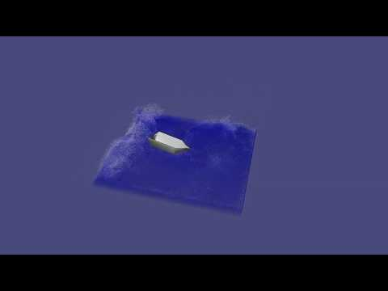
Video

Slide 3
Physics
Explicit WCSPH solver with boundary handling [1]
[1] PBS lecture on SPH + Eurographics Tutorial 2019, section “Boundary handling”

Slide 4
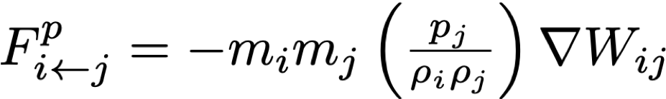
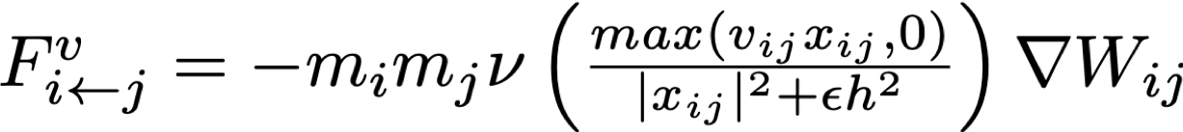
Physics
Explicit WCSPH solver with boundary handling [1]
Two-way rigid body-water coupling [2]
Repulsion
Friction
[1] PBS lecture on SPH + Eurographics Tutorial 2019, section “Boundary handling”
[2] Akinci et al., “Versatile Rigid-Fluid Coupling for Incompressible SPH”, 2012

Slide 5
Physics
Explicit WCSPH solver with boundary handling [1]
Two-way rigid body-water coupling [2]
Rigid body movement with boundary repulsion
Repulsion
Friction
[1] PBS lecture on SPH + Eurographics Tutorial 2019, section “Boundary handling”
[2] Akinci et al., “Versatile Rigid-Fluid Coupling for Incompressible SPH”, 2012

Slide 6
Physics
Explicit WCSPH solver with boundary handling [1]
Two-way rigid body-water coupling [2]
Rigid body movement with boundary repulsion
Parameters tuning
Repulsion
Friction
[1] PBS lecture on SPH + Eurographics Tutorial 2019, section “Boundary handling”
[2] Akinci et al., “Versatile Rigid-Fluid Coupling for Incompressible SPH”, 2012

Slide 7
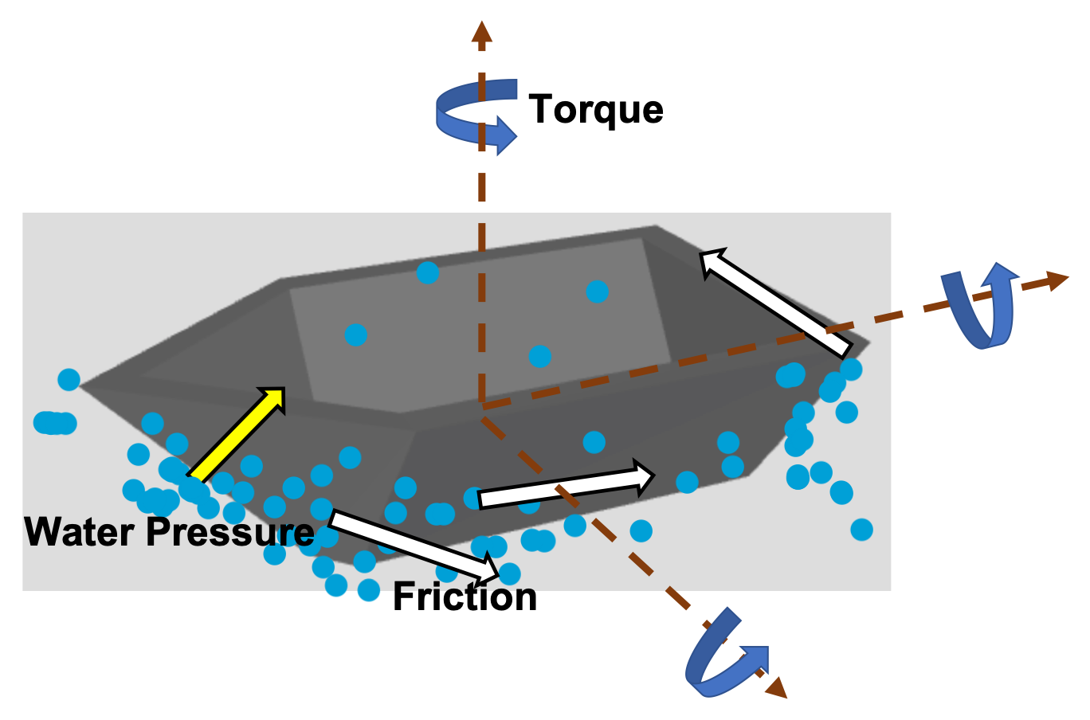
Water - Boat forces

Slide 8
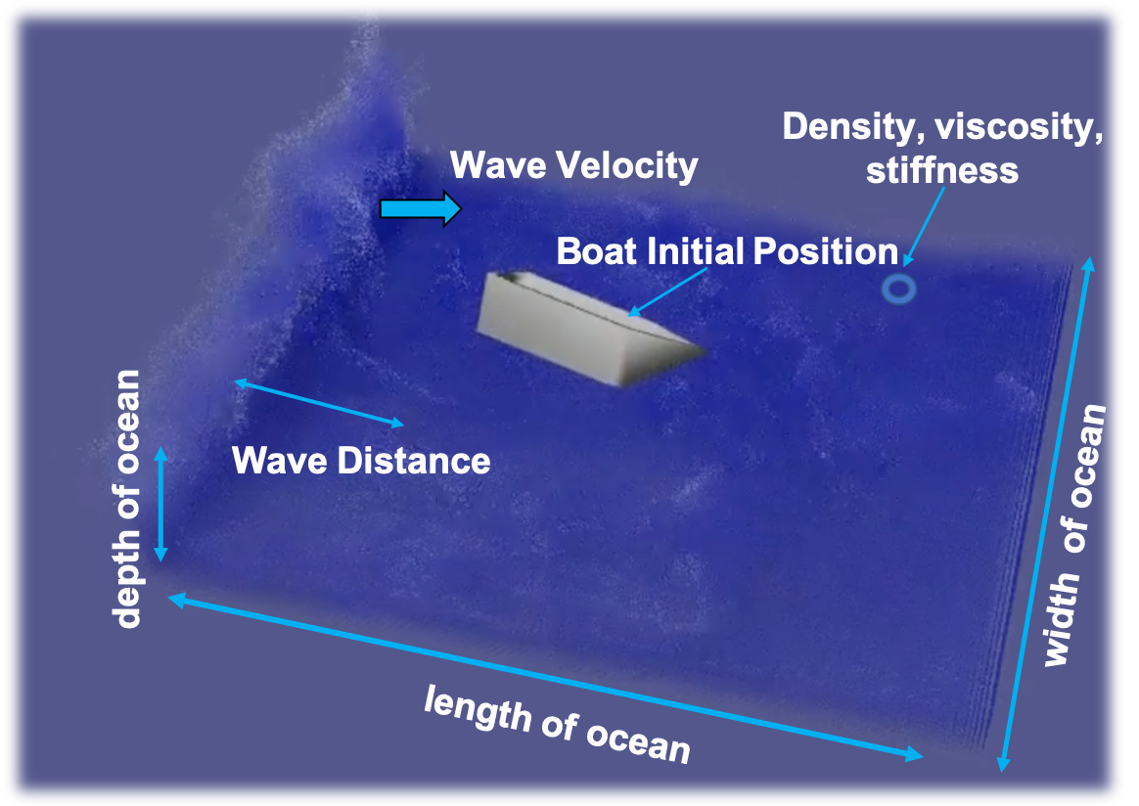
Interactive parameters
контраст маленький.
Мб белый цвет текста?

Slide 9
Optimizations
Cache locality (~2x)
Grid contains vector of particles and list of pointers to Neighbor-grids lists
Particle struct fit in cache-line. Using floats instead of doubles.
Bottleneck is particle interactions, not re-arrangements.
An iteration of ~1.1M particles | Time (ms)
Reset densities and forces | 27.803
Sum densities | (34.5%) 306.700
Update pressures | 15.378
Sum forces | (48.3%) 429.419
Update velocities and positions | 38.583
Re-arrange particles | (8%) 71.722
Total | 889.605

Slide 10
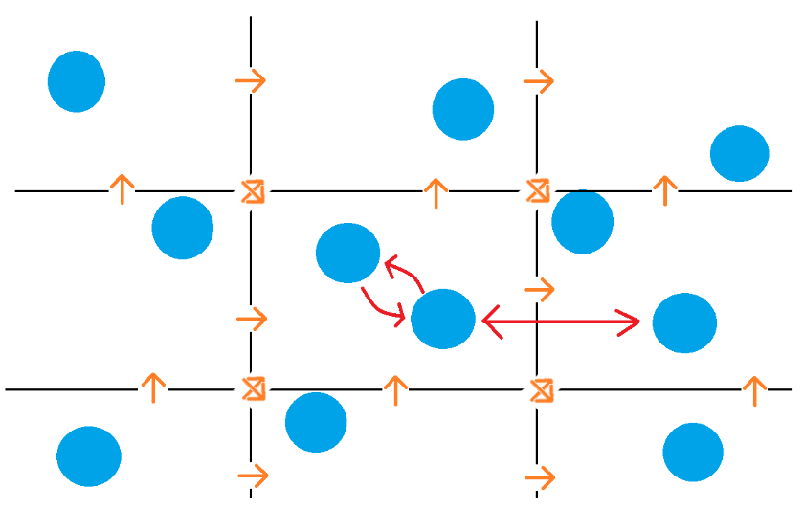
Optimizations
Cache locality
Grid contains vector of particles and list of pointers to Neighbor-grids lists
Particle struct fit in cache-line. Using floats instead of doubles.
Bottleneck is particle interactions, not re-arrangements.
Double update (~1.5x)
Filters neighbor search

Slide 11
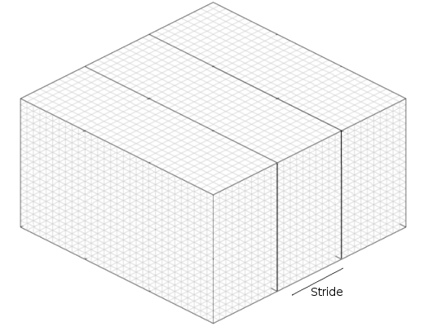
Optimizations
Cache locality
Grid contains vector of particles and list of pointers to Neighbor-grids lists
Particle struct fit in cache-line. Using floats instead of doubles.
Bottleneck is particle interactions, not re-arrangements.
Double update
Filters neighbor search
Parallelization (2 cores 4 threads, ~2x)
OpenMp
Reduced cache coherence overhead by strides

Slide 12
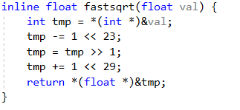
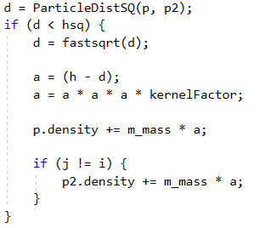
Optimizations
Cache locality
Grid contains vector of particles and list of pointers to Neighbor-grids lists
Particle struct fit in cache-line. Using floats instead of doubles.
Bottleneck is particle interactions, not re-arrangements.
Double update
Filters neighbor search
Parallelization
OpenMp
Reduced cache coherence overhead by strides
Low - level optimizations (~2x)
Avoid pow and sqrt
Reuse part of calculations in temp variables

Slide 13
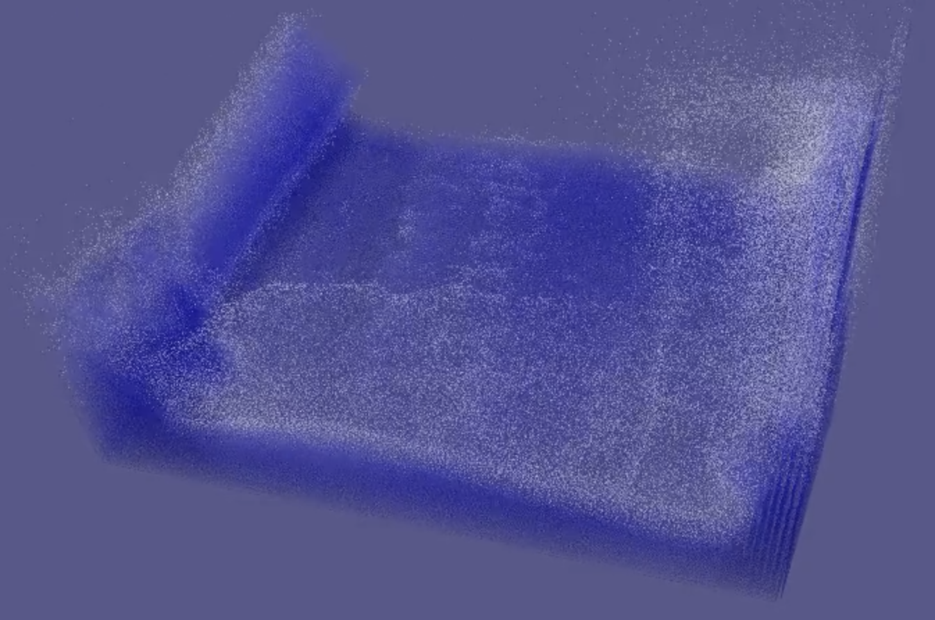
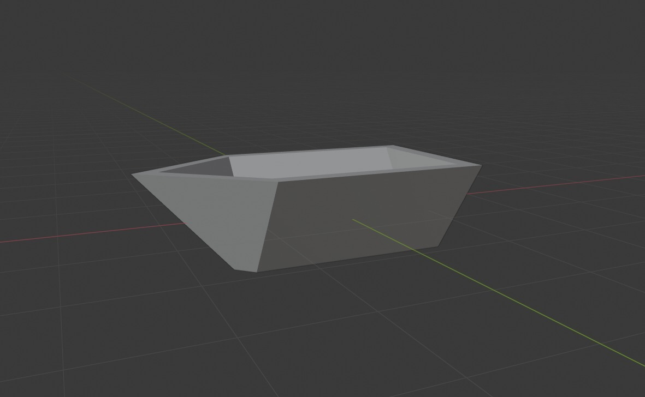
Visualization
Dot position/color matrices
Color based on density - foam imitation
OpenGL dot transparency
Blender used to make boat .obj file
Render to bitmap @ 30fps
FFmpeg converts bitmap to video

Slide 14
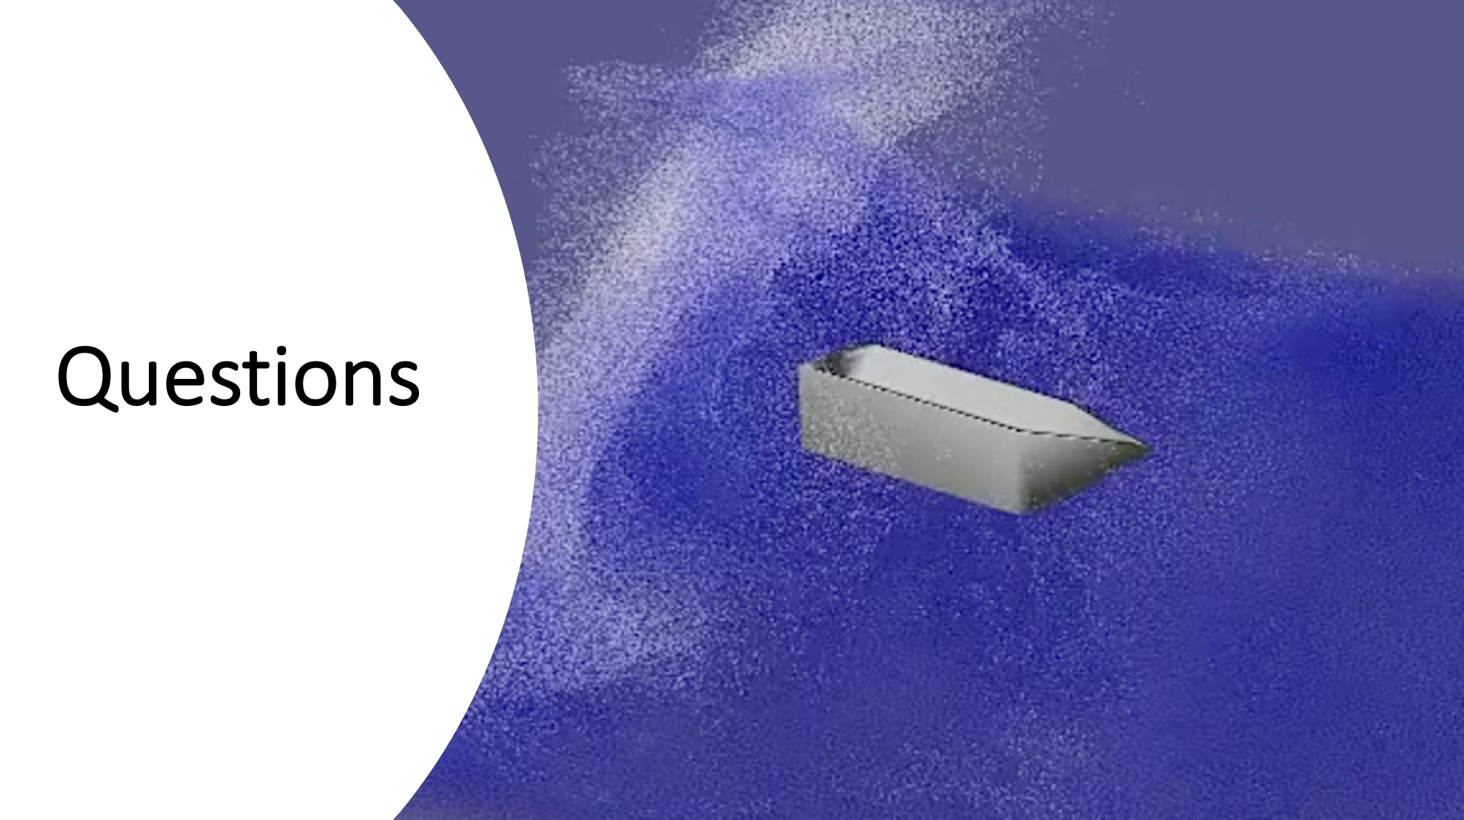

Slide 15
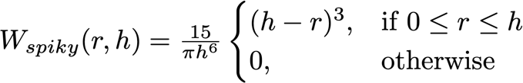
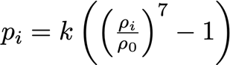
Spiky kernel
Pressure
Viscosity
Parameters

